Slide 1
MET CS 555 – Foundations of Machine Learning Lecture 9: One-way Analysis of Variance
Hongsheng Wu
Boston University

Slide 2
Study Guide
One-Way Analysis of Variance
Pairwise Comparisons
Type I and Type II Errors

Slide 3
One-Way Analysis of Variance
Notes:
A two-way ANOVA is used to estimate how the mean of a quantitative variable changes according to the levels of two categorical variables.

Slide 4
One-Way Analysis of Variance
Analysis of variance is a general term that involves breaking down the overall variability in a particular continuous outcome into pieces
It involves comparing the variability after accounting for a characteristic versus the remaining variability not explained by the characteristic and just inherent to the outcome
In the one-way analysis of variance (ANOVA), we study groups that are defined based on the value of one factor
The goal of a one-way ANOVA is to compare means across groups
In the ANOVA framework, we make comparisons across several groups while considering all of the data together

Slide 5
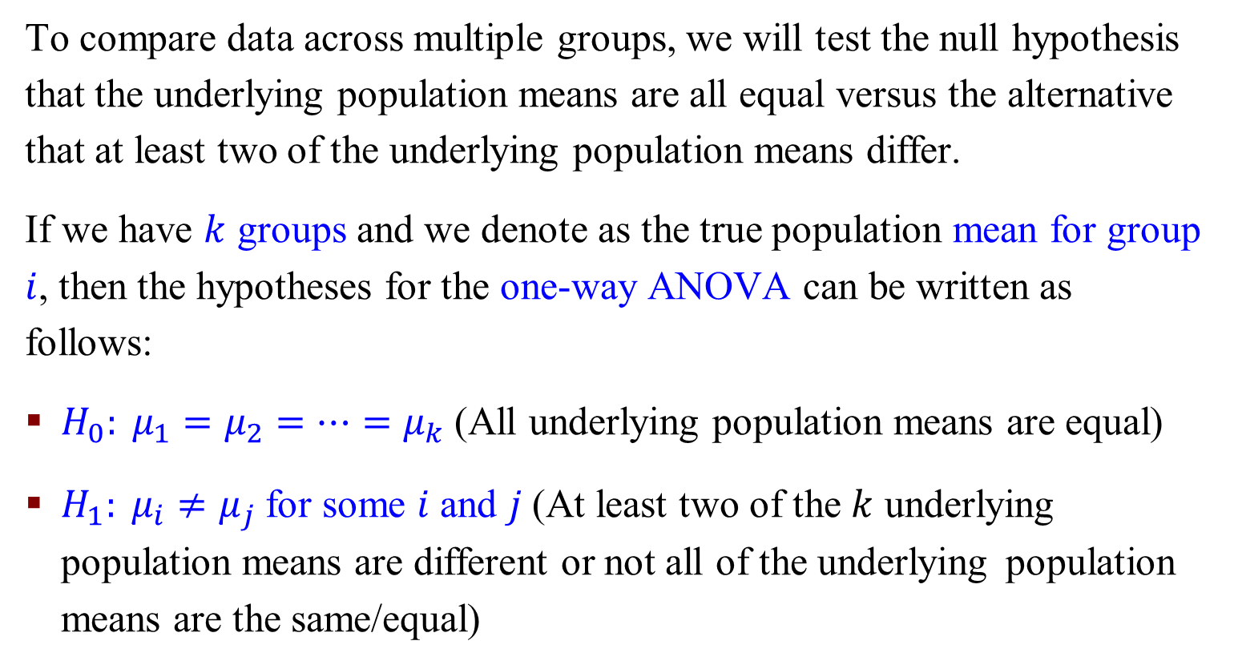
One-Way Analysis of Variance
To compare data across multiple groups, we will test the null hypothesis that the underlying population means are all equal versus the alternative that at least two of the underlying population means differ.
If we have $k$ groups and we denote as the true population mean for group $i$, then the hypotheses for the one-way ANOVA can be written as follows:
$H_{0}: μ_{1}=μ_{2}=…=μ_{k}$ (All underlying population means are equal)
$H_{1}: μ_{i}≠μ_{j}$for some $i$ and $j$(At least two of the $k$ underlying population means are different or not all of the underlying population means are the same/equal)

Slide 6
Example - One-Way Analysis of Variance
Commercials aired on TV entice potential buyers to consider purchasing a specific brand of golf balls by claiming increased driving distances. In order to see which brand of golf balls is best (as measured by distance traveled), an experiment is set up where a mechanical driver hits 5 balls of each of 3 brands. The distance in yards achieved after each strike is measured.

Slide 7
Example - One-Way Analysis of Variance
In both cases, the sample means for each brand are the same. The difference between the two versions of the examples is the amount of variability in the outcome. When the variability is small relative to the differences between means, we become increasingly likely to declare that groups differ from each other.

Slide 8
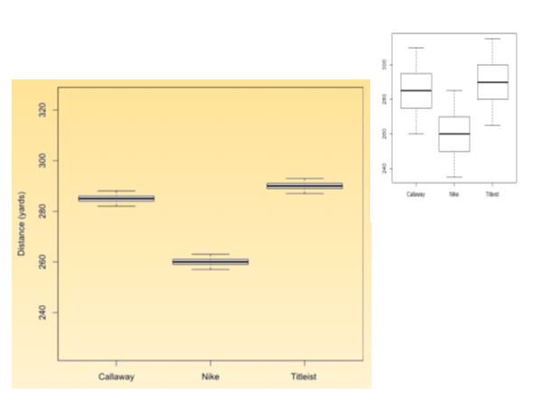

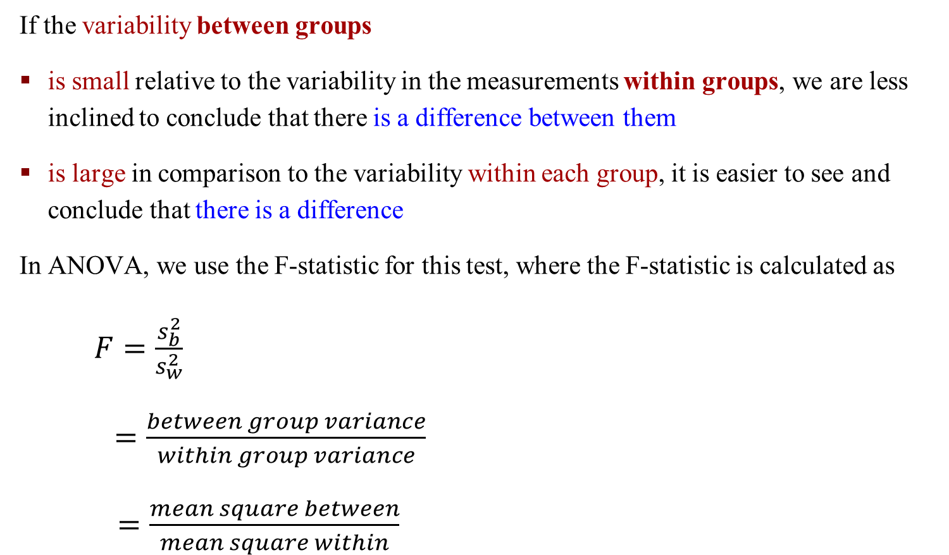
One-Way Analysis of Variance
If the variability between groups
is small relative to the variability in the measurements within groups, we are less inclined to conclude that there is a difference between them
is large in comparison to the variability within each group, it is easier to see and conclude that there is a difference
In ANOVA, we use the F-statistic for this test, where the F-statistic is calculated as
$F=\frac{s_{b}^{2}}{s_{w}^{2}}$
$=\frac{between group variance}{within group variance}$
$=\frac{mean square between}{mean square within}$
$$F=\frac{Reg MS}{Res MS}$$

Slide 9
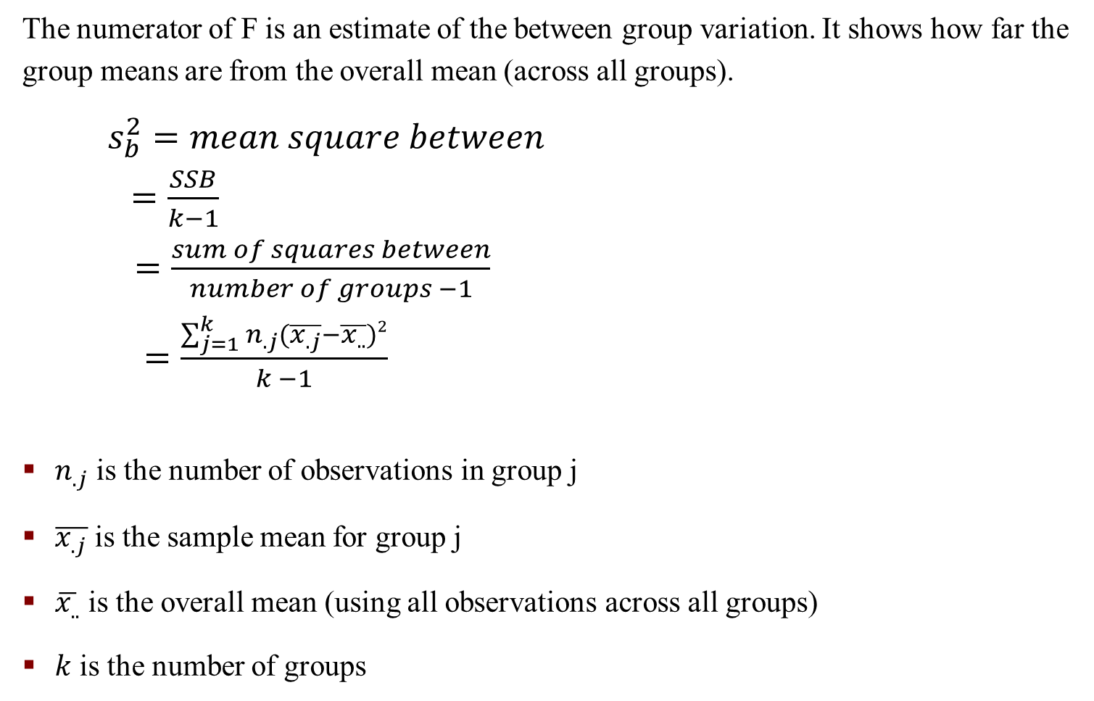
One-Way Analysis of Variance
The numerator of F is an estimate of the between group variation. It shows how far the group means are from the overall mean (across all groups).
$s_{b}^{2}=mean square between$
$=\frac{SSB}{k−1}$
$=\frac{sum of squares between}{number of groups −1}$
$=\frac{\sum_{j=1}^{k}{n_{.j}(\overline{x_{.j}}}−\overline{x_{..}})2}{k −1}$
$n_{.j}$ is the number of observations in group j
$\overline{x_{.j}}$ is the sample mean for group j
$\overline{x_{..}}$ is the overall mean (using all observations across all groups)
$k$ is the number of groups

Slide 10
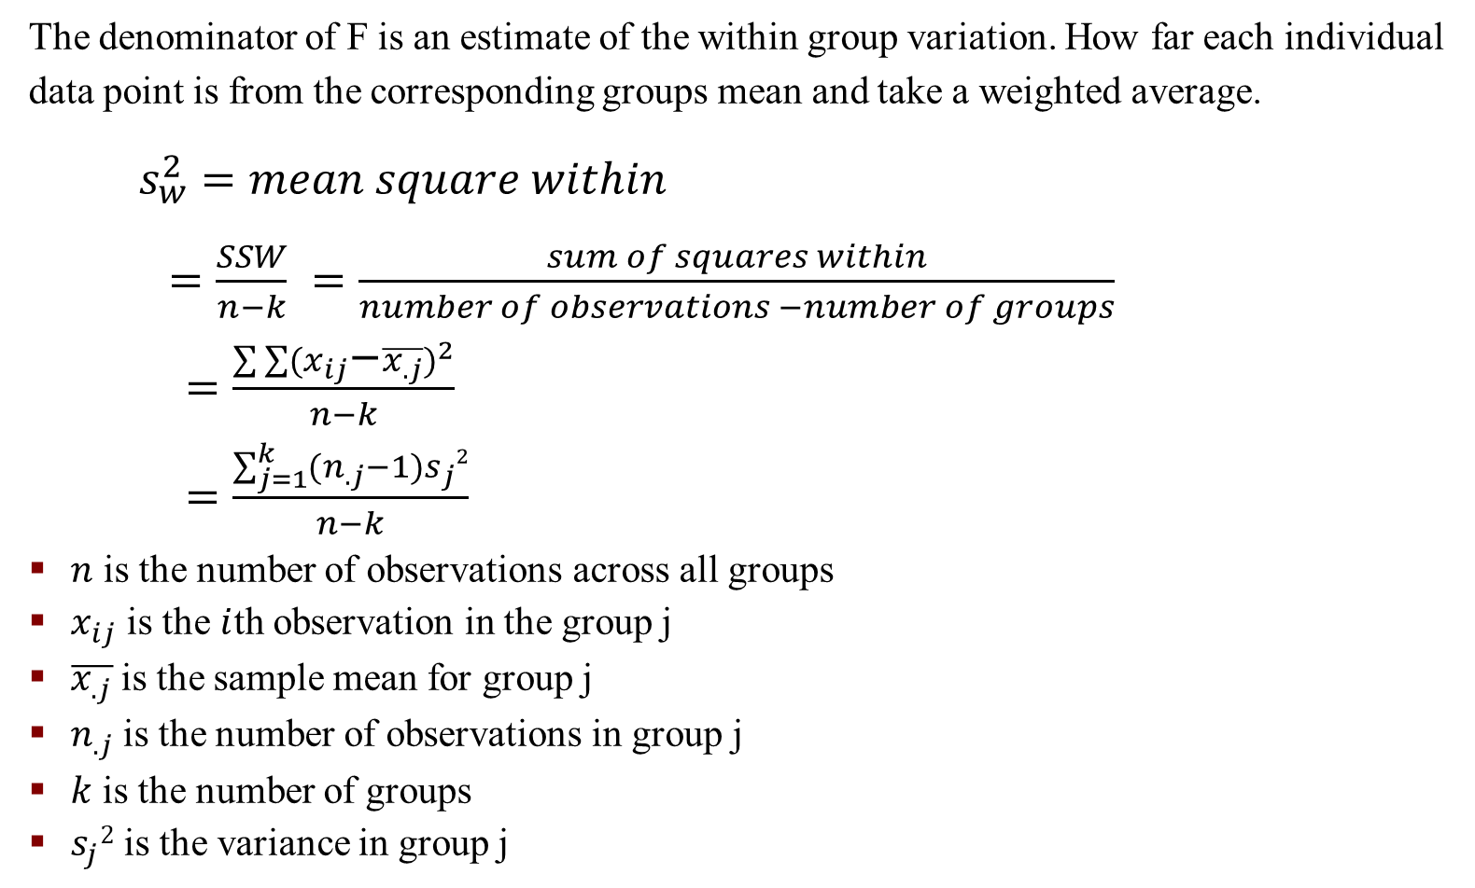
One-Way Analysis of Variance
The denominator of F is an estimate of the within group variation. How far each individual data point is from the corresponding groups mean and take a weighted average.
$s_{w}^{2}=mean square within$
$=\frac{SSW}{n−k}$ $=\frac{sum of squares within}{number of observations −number of groups}$
$=\frac{\sum{\sum{{(x_{ij}−\overline{x_{.j}})}^{2}}}}{n−k}$
$=\frac{\sum_{j=1}^{k}{{(n}_{.j}}−1)s_{j}2}{n−k}$
$n$ is the number of observations across all groups
$x_{ij}$ is the $i$th observation in the group j
$\overline{x_{.j}}$is the sample mean for group j
$n_{.j}$is the number of observations in group j
$k$ is the number of groups
$s_{j}2$ is the variance in group j

Slide 11
One-Way Analysis of Variance – An Example

Slide 12
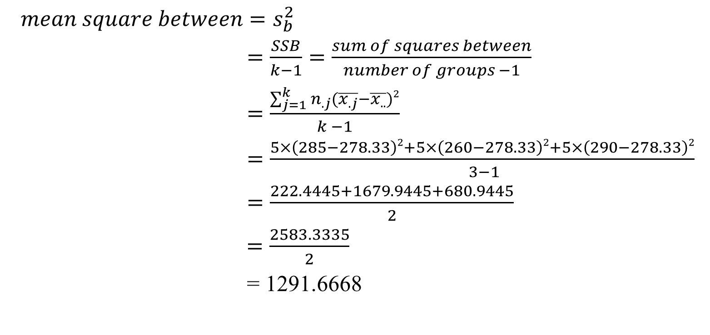
One-Way ANOA – An Example – Mean Square Between
$$mean square between=s_{b}^{2}$$
$=\frac{SSB}{k−1}=\frac{sum of squares between}{number of groups −1}$
$=\frac{\sum_{j=1}^{k}{n_{.j}(\overline{x_{.j}}}−\overline{x_{..}})2}{k −1}$
$=\frac{5×\left(285−278.33\right)2+5×\left(260−278.33\right)2+5×\left(290−278.33\right)2}{ 3−1}$
$=\frac{222.4445+1679.9445+680.9445}{2}$
$=\frac{2583.3335}{2}$
= 1291.6668

Slide 13
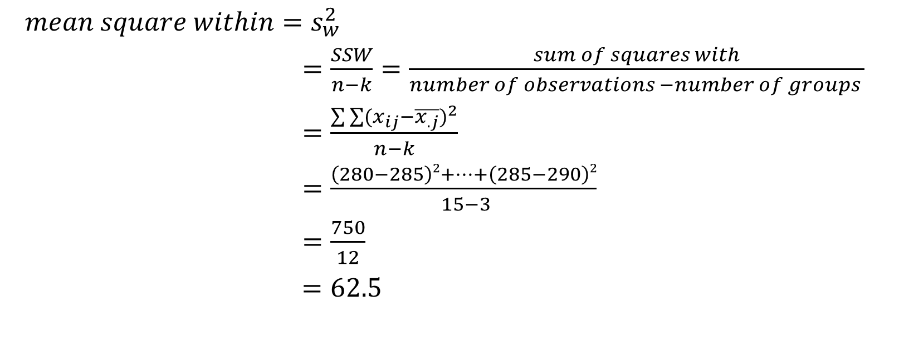
One-Way ANOA – An Example – Mean Square Within
$$mean square within=s_{w}^{2}$$
$=\frac{SSW}{n−k}=\frac{sum of squares with}{number of observations −number of groups }$
$=\frac{\sum{\sum{{(x_{ij}−\overline{x_{.j}})}^{2}}}}{n−k}$
$=\frac{\left(280−285\right)2+…+\left(285−290\right)2}{ 15−3}$
$=\frac{750}{12}$
$=62.5$

Slide 14

One-way ANOVA
The deviation between an individual point and the overall mean is comprised of two parts:
1. deviation between the individual point and the respective group mean
2. deviation between the group mean and the overall mean
$x_{ij}−\overline{x_{..}}=x_{ij}−\overline{x_{.j}}+x_{.j}−\overline{x_{..}}=\left(x_{ij}−\overline{x_{.j}}\right)+$ ($x_{.j}−\overline{x_{..}}$)

Slide 15
One-way Analysis of Variance
The deviation between the individual point and the respective group mean is representative of the within group variability. The deviation between the group mean and the overall mean is representative of the between group variability
If the between group variability is large and the within group variability is small, then the null hypothesis is often rejected (in favor of the alternative hypothesis that the underlying means across groups are not all equal)
Large values of the F-statistic indicate that the variation between groups is larger than the variation within each individual group
To know how large is large enough to reject the null hypothesis, we use the F-distribution with k-1 and n-k degrees of freedom

Slide 16
Inference – F-test – Global Test
The F-test derived from the ANOVA table is sometimes referred to as the global test.
The global F-test only has the ability to conclude that there are group differences (if the null hypothesis is rejected), but does not allow one to know which groups are different without taking further steps to investigate where the differences lie.

Slide 17

Inference – Anova Table
$$SSB=\sum_{j=1}^{k}{n_{.j}(\overline{x_{.j}}}−\overline{x_{..}})2$$
$$SSW=\sum{\sum{{(x_{ij}−\overline{x_{.j}})}^{2}}}$$
$$Total SS= \sum{\sum{{(x_{ij}−\overline{x_{..}})}^{2}}}$$
$$F=\frac{MSB}{MSW}=s_{b}^{2}/s_{w}^{2}$$

Slide 18
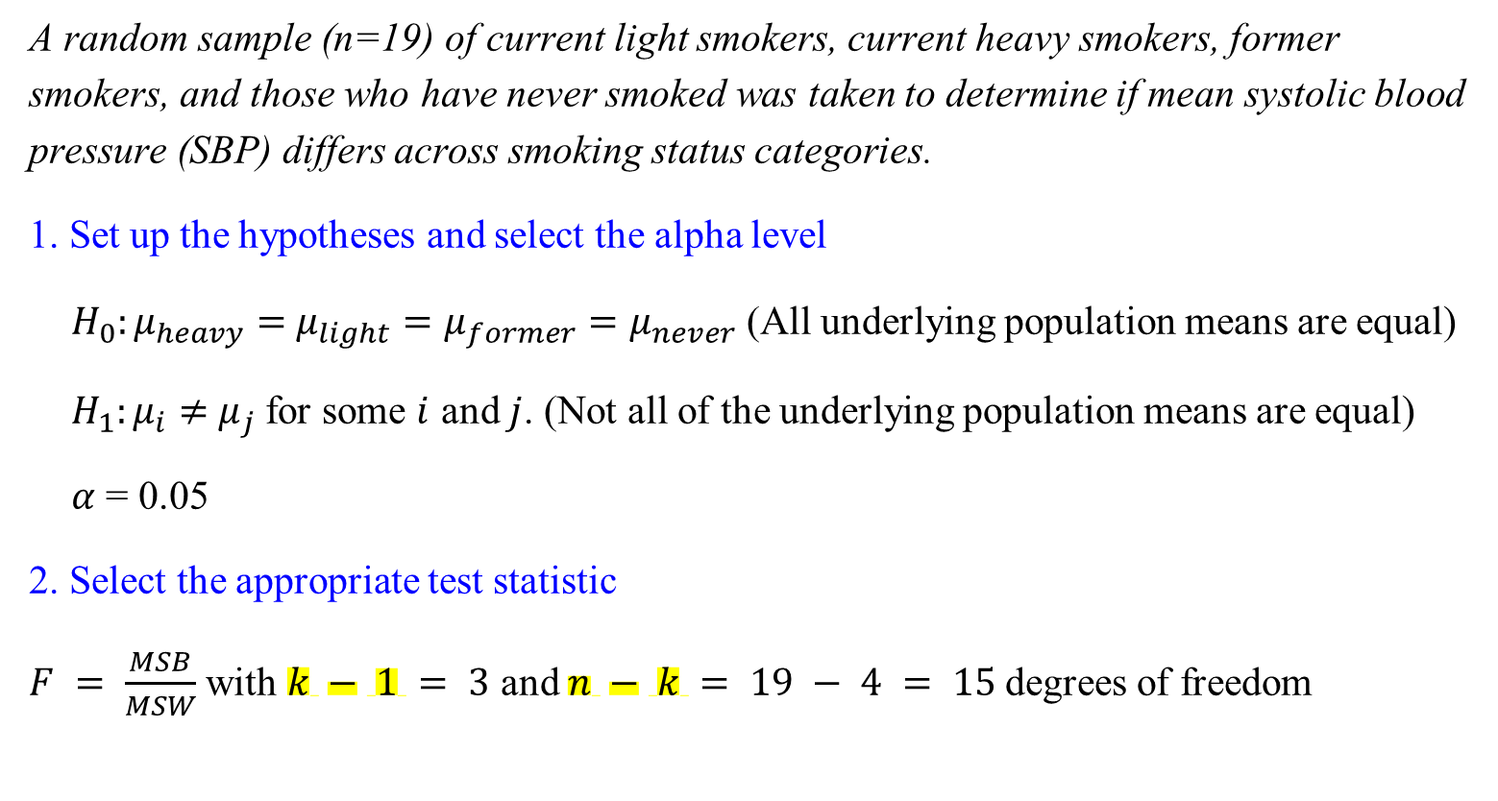
F-test for ANOVA: An Example
A random sample (n=19) of current light smokers, current heavy smokers, former smokers, and those who have never smoked was taken to determine if mean systolic blood pressure (SBP) differs across smoking status categories.
1. Set up the hypotheses and select the alpha level
$H_{0}:μ_{heavy}=$ $μ_{light}=μ_{former}=μ_{never}$ (All underlying population means are equal)
$H_{1}:μ_{i}≠$ $μ_{j}$for some $i$ and $j$. (Not all of the underlying population means are equal)
$α$ = 0.05
2. Select the appropriate test statistic
$F = \frac{MSB}{MSW}$ with $k − 1 = 3$ and $n − k = 19 − 4 = 15$degrees of freedom

Slide 19
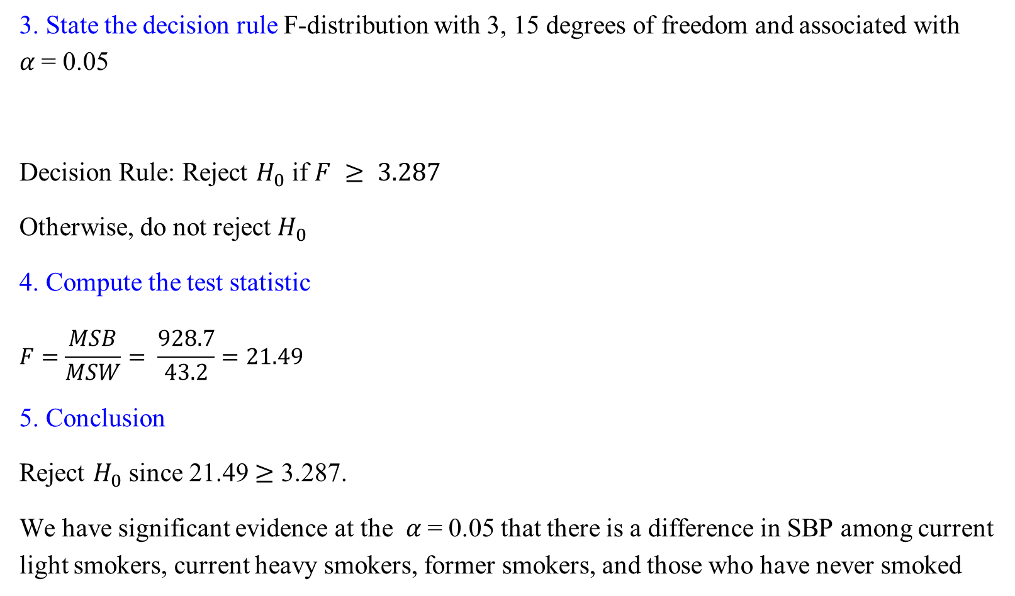
F-test for ANOVA: An Example
3. State the decision rule F-distribution with 3, 15 degrees of freedom and associated with $α$= 0.05
Decision Rule: Reject $H_{0}$ if $F ≥ 3.287$
Otherwise, do not reject $H_{0}$
4. Compute the test statistic
$$F=\frac{MSB}{MSW}= \frac{928.7}{43.2}=21.49$$
5. Conclusion
Reject $H_{0}$ since 21.49 $≥$ 3.287.
We have significant evidence at the $α$= 0.05 that there is a difference in SBP among current light smokers, current heavy smokers, former smokers, and those who have never smoked

Slide 20
F-test for ANOVA: An Example – Using R
Notes:
We use aov() when we would like to fit an ANOVA model and view the results in an ANOVA summary table.
We use anova() when we would like to compare the fit of nested regression models

Slide 21
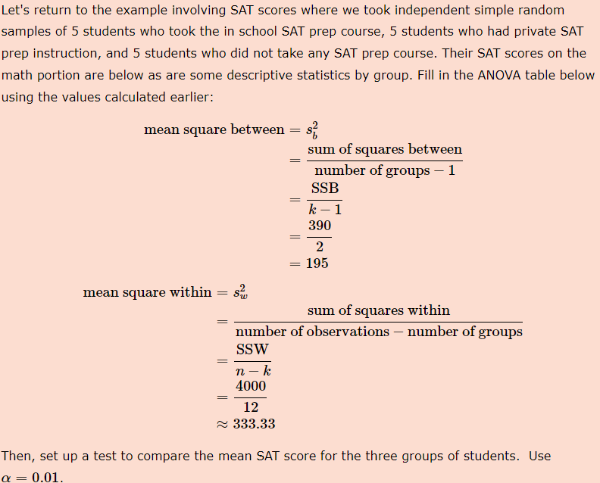
Exercise

Slide 22
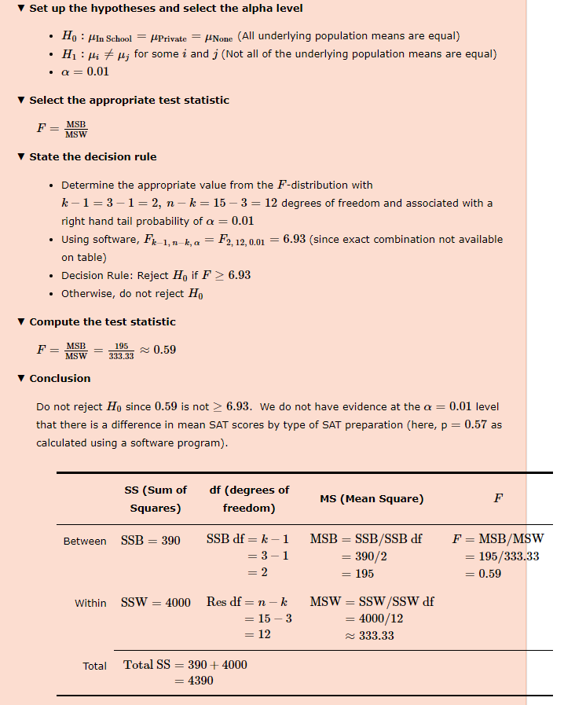

Slide 23
Pairwise Comparisons

Slide 24

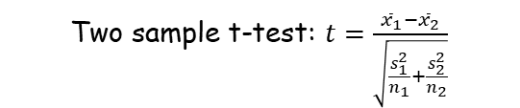
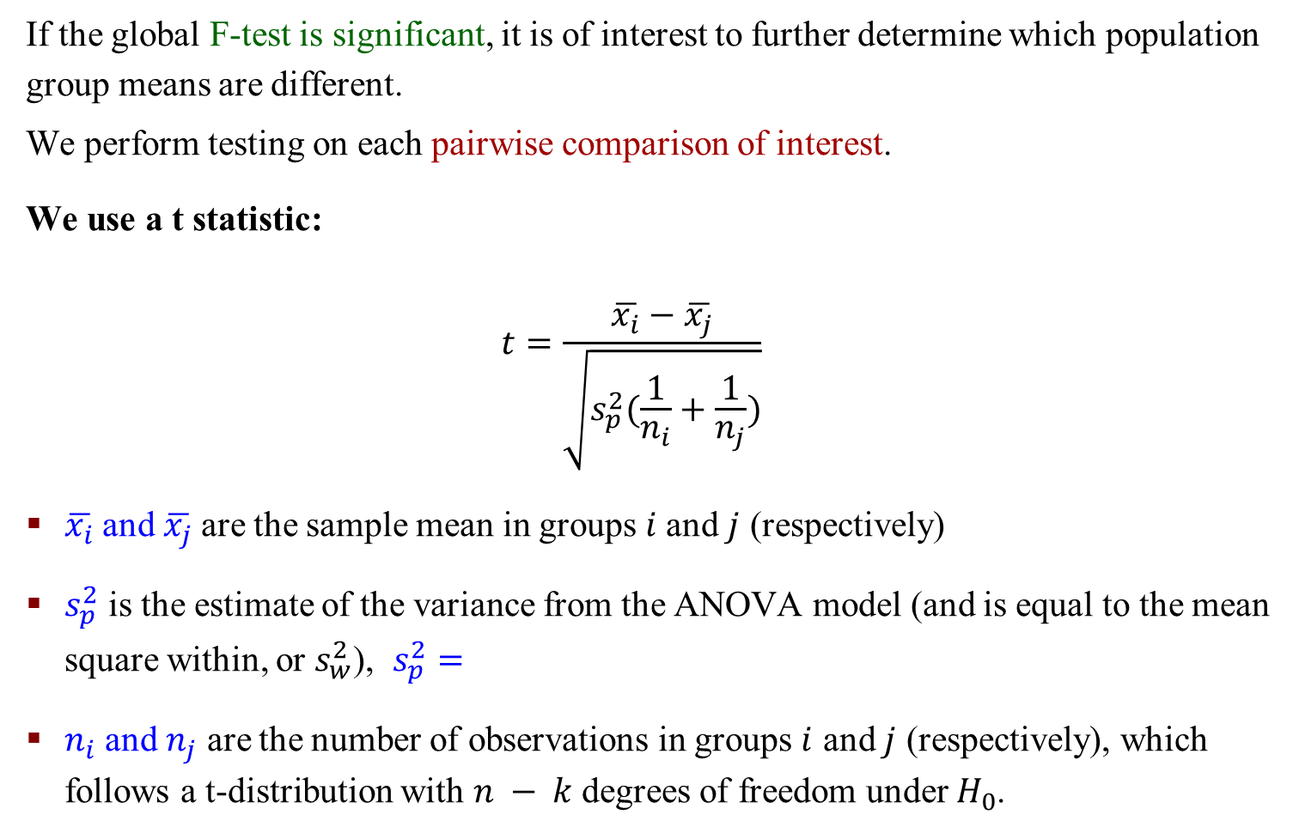
Evaluating Group Differences – t-test
If the global F-test is significant, it is of interest to further determine which population group means are different.
We perform testing on each pairwise comparison of interest.
We use a t statistic:
$$t=\frac{\overline{x_{i}}−\overline{x_{j}}}{\sqrt{s_{p}^{2}(\frac{1}{n_{i}}+\frac{1}{n_{j}})}}$$
$\overline{x_{i}}$and $\overline{x_{j}}$are the sample mean in groups $i$and $j$ (respectively)
$s_{p}^{2}$ is the estimate of the variance from the ANOVA model (and is equal to the mean square within, or $s_{w}^{2}$), $s_{p}^{2}=$
$n_{i}$and $n_{j}$ are the number of observations in groups $i$ and $j$ (respectively), which follows a t-distribution with $n − k$degrees of freedom under $H_{0}$.
Two sample t-test: $t=\frac{{\overline{x}}_{1}−{\overline{x}}_{2}}{\sqrt{\frac{s_{1}^{2}}{n_{1}}+\frac{s_{2}^{2}}{n_{2}}}}$

Slide 25
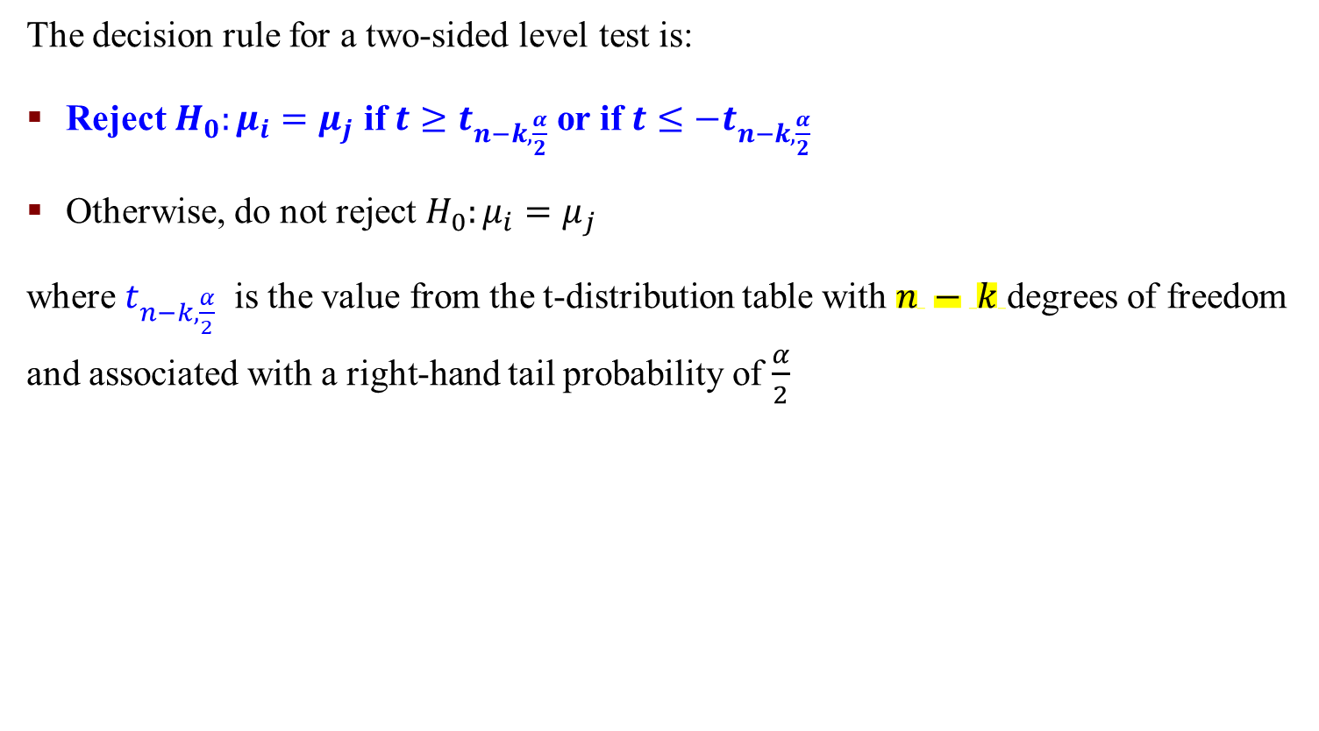
Evaluating Group Differences – t-test
The decision rule for a two-sided level test is:
Reject $H_{0}:μ_{i}=μ_{j}$ if $t≥t_{n−k,\frac{α}{2}}$ or if $t≤{−t}_{n−k,\frac{α}{2}}$
Otherwise, do not reject $H_{0}:μ_{i}=μ_{j}$
where $t_{n−k,\frac{α}{2}}$ is the value from the t-distribution table with $n − k$degrees of freedom and associated with a right-hand tail probability of $\frac{α}{2}$

Slide 26
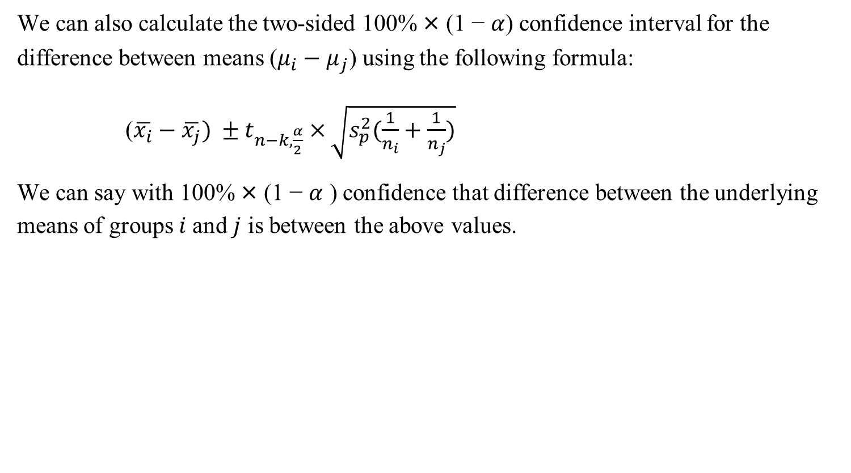
Evaluating Group Differences – t-test – Confidence Interval
We can also calculate the two-sided 100% × (1 − $α$) confidence interval for the difference between means ($μ_{i}−μ_{j}$) using the following formula:
($\overline{x_{i}}−\overline{x_{j}}) ±t_{n−k,\frac{α}{2}}$ $×\sqrt{s_{p}^{2}(\frac{1}{n_{i}}+\frac{1}{n_{j}})}$
We can say with 100% × (1 − $α$ ) confidence that difference between the underlying means of groups $i$and $j$ is between the above values.

Slide 27
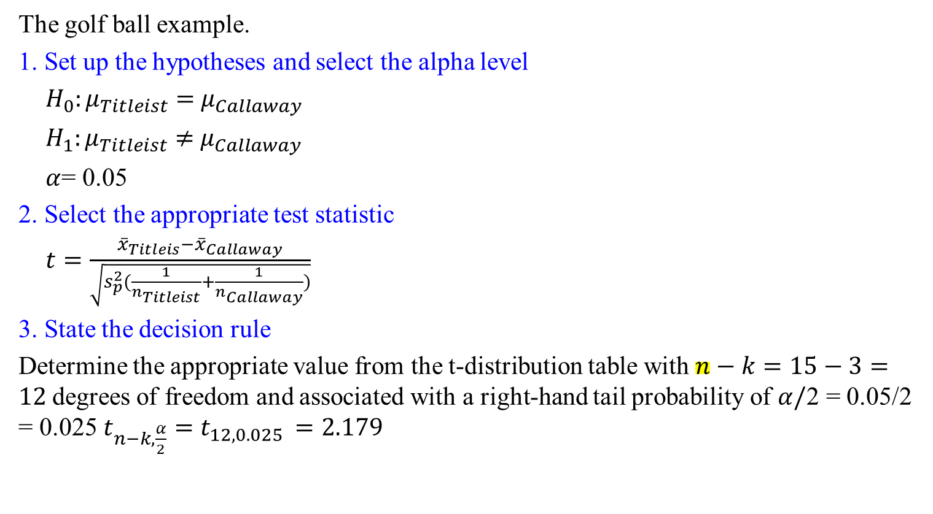
Example: t-test
The golf ball example.
1. Set up the hypotheses and select the alpha level
$H_{0}:μ_{Titleist}=$ $μ_{Callaway}$
$H_{1}:μ_{Titleist}≠$ $μ_{Callaway}$
$α$= 0.05
2. Select the appropriate test statistic
$t=\frac{{\overline{x}}_{Titleis}−{\overline{x}}_{Callaway}}{\sqrt{s_{p}^{2}(\frac{1}{n_{Titleist}}+\frac{1}{n_{Callaway}})}}$
3. State the decision rule
Determine the appropriate value from the t-distribution table with $n−k=15−3=12$degrees of freedom and associated with a right-hand tail probability of $α/$2 = 0.05/2 = 0.025 $t_{n−k,\frac{α}{2}}=t_{12,0.025 }=2.179$

Slide 28
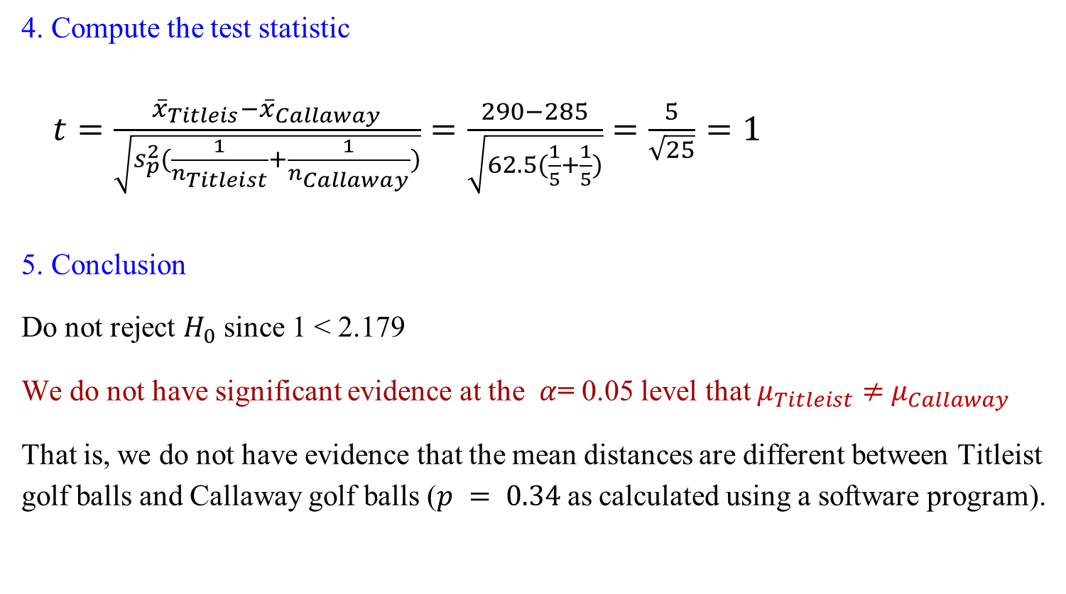
Example: t-test (continued)
4. Compute the test statistic
$t=\frac{{\overline{x}}_{Titleis}−{\overline{x}}_{Callaway}}{\sqrt{s_{p}^{2}(\frac{1}{n_{Titleist}}+\frac{1}{n_{Callaway}})}}=\frac{290−285}{\sqrt{62.5(\frac{1}{5}+\frac{1}{5})}}=\frac{5}{\sqrt{25}}=1$
5. Conclusion
Do not reject $H_{0}$ since 1 < 2.179
We do not have significant evidence at the $α$= 0.05 level that $μ_{Titleist}≠$ $μ_{Callaway}$
That is, we do not have evidence that the mean distances are different between Titleist golf balls and Callaway golf balls ($p = 0.34$as calculated using a software program).

Slide 29
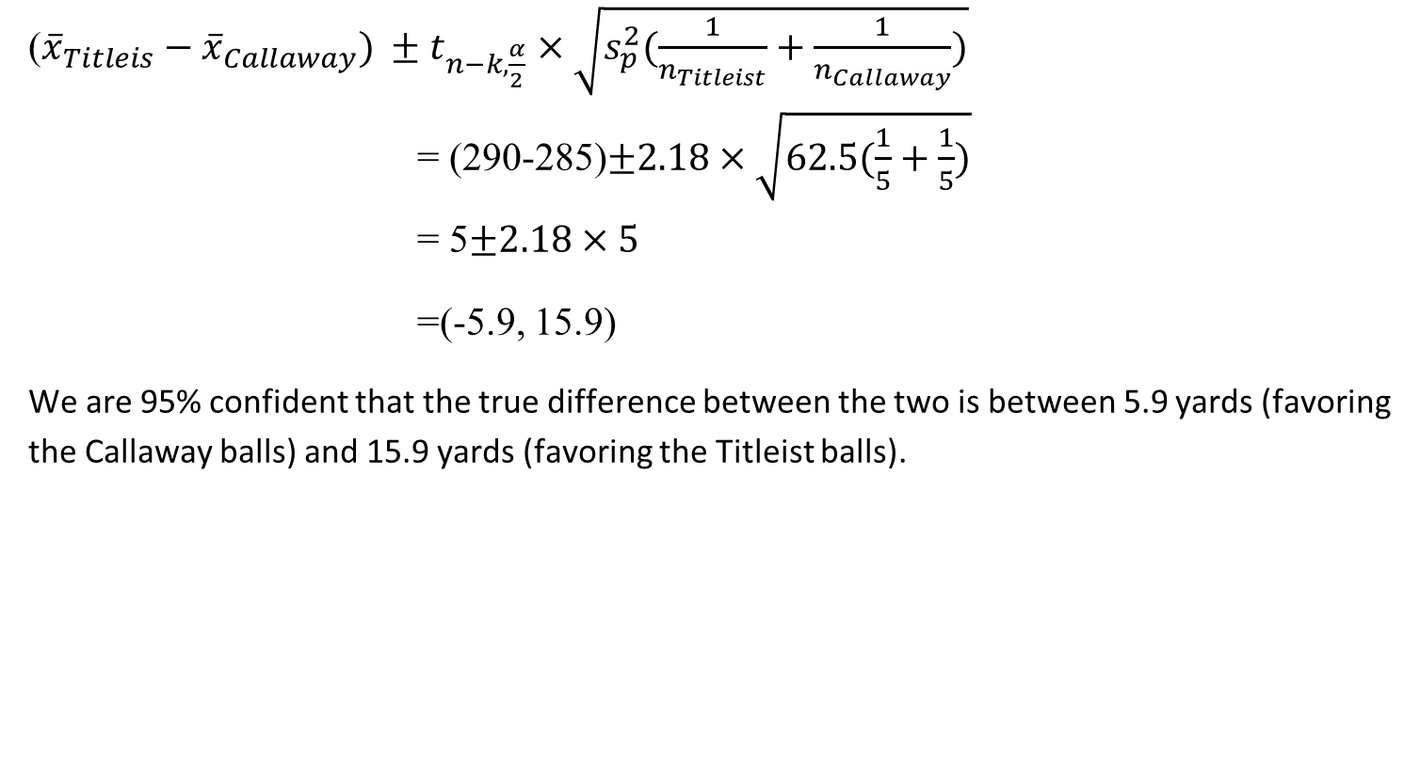
Example: t-test (continued)
(${\overline{x}}_{Titleis}−{\overline{x}}_{Callaway}) ±t_{n−k,\frac{α}{2}}$ $×\sqrt{s_{p}^{2}(\frac{1}{n_{Titleist}}+\frac{1}{n_{Callaway}})}$
= (290-285)$±2.18×\sqrt{62.5(\frac{1}{5}+\frac{1}{5})}$
= 5$±2.18×5$
=(-5.9, 15.9)
We are 95% confident that the true difference between the two is between 5.9 yards (favoring the Callaway balls) and 15.9 yards (favoring the Titleist balls).

Slide 30
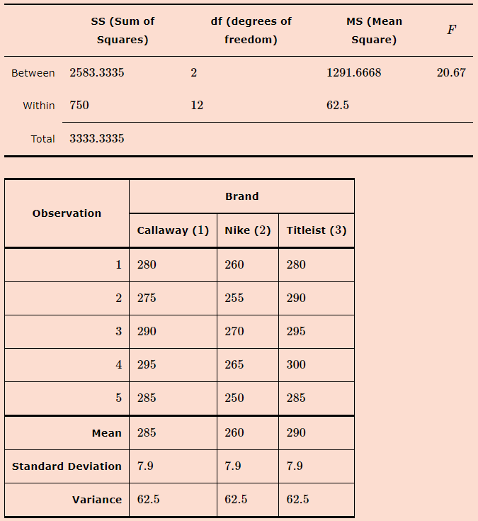
Exercise
Use the raw data and the ANOVA table below to test whether the mean distance of Callaway brand balls differs from the mean distance of Nike brand golf balls. Formally set up this test and use α=0.05

Slide 31
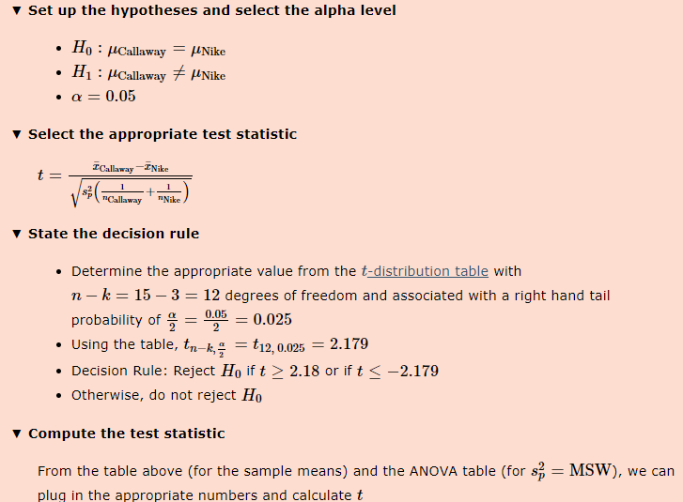
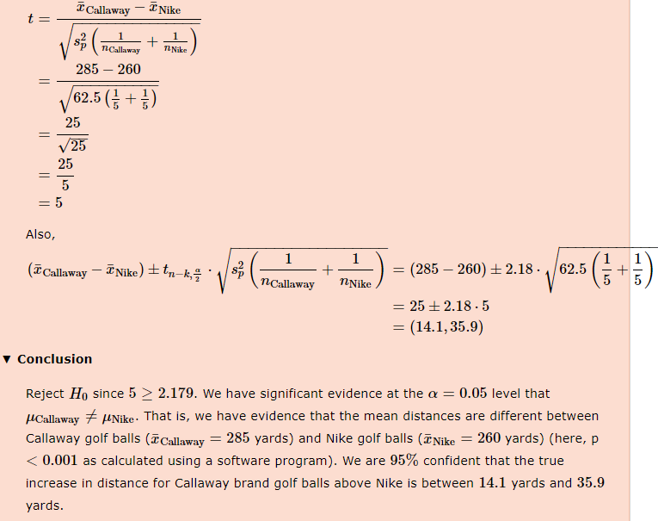

Slide 32
Example: t-test R Command
Notes:
aggregate function to compute summary statistics for subsets of the data
Result is p value

Slide 33
Type I and type II errors

Slide 34
Type I Error
Type I Error: rejecting the null hypothesis when it is true (false positive)
The probability of making a Type I Error is controlled by the significance level of the test. It is generally the error rate that we worry the most about
The potential implications of this type of error explain why we specify small values of alpha (the significance level)
The potential implications of this type of error necessitates the need to report p-values in your summary of results
Notes:
Alpha small, which we hard to make type 1 Error to false reject H₀

Slide 35
Type II Error
Type II Error: failing to reject the null hypothesis when it is not true (false negative)
The probably of making a Type II Error is controlled by the sample size. The probability decreases with increasing sample size.
The Type II Error is known as the power of a test (the probability of rejecting the null hypothesis when the null hypothesis is not true).

Slide 36
Type II Error
When we fail to reject the null hypothesis, it is often difficult to know whether or not we didn't have enough power or if the null hypothesis was indeed true.
This is why we don’t say we accept the null hypothesis. Instead, we state our conclusion as failing to reject the null hypothesis or having insufficient evidence to reject the null hypothesis.
Since the probability of type II error decreases as the sample size increases, type II error rates of 10% or less are often selected for such settings.
In most other cases, a type II error rate of 20% is generally considered reasonable for planning purposes.

Slide 37

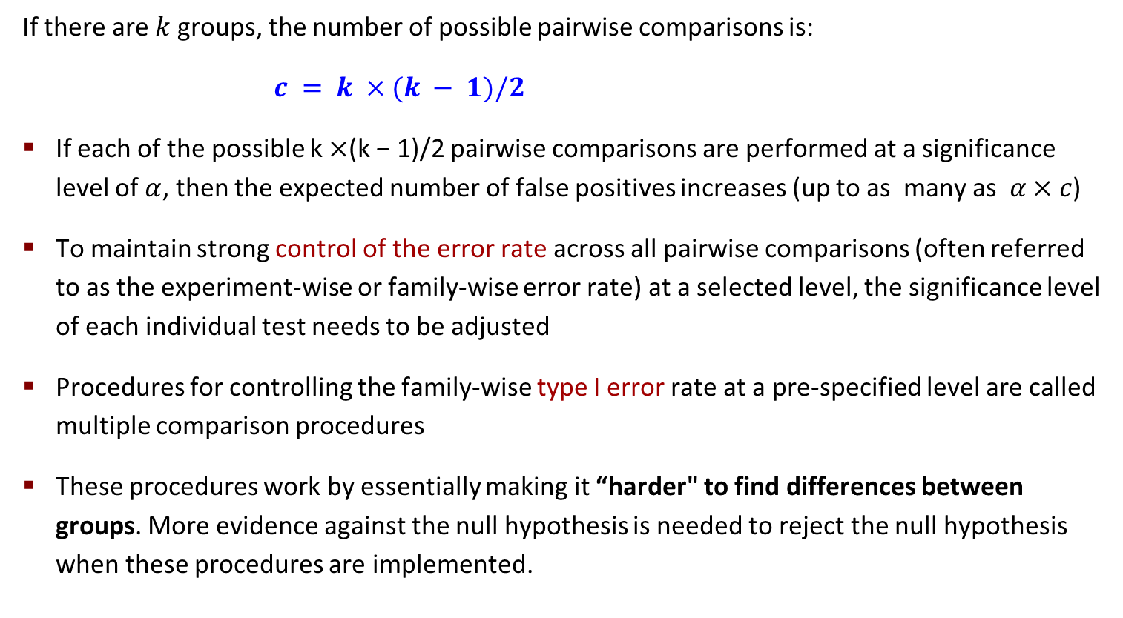
Issues with Multiple Comparisons
If there are $k$groups, the number of possible pairwise comparisons is:
$c = k ×(k − 1)/2$
If each of the possible k $×$(k − 1)/2 pairwise comparisons are performed at a significance level of $α$, then the expected number of false positives increases (up to as many as $α×c$)
To maintain strong control of the error rate across all pairwise comparisons (often referred to as the experiment-wise or family-wise error rate) at a selected level, the significance level of each individual test needs to be adjusted
Procedures for controlling the family-wise type I error rate at a pre-specified level are called multiple comparison procedures
These procedures work by essentially making it “harder" to find differences between groups. More evidence against the null hypothesis is needed to reject the null hypothesis when these procedures are implemented.
$$1−(1−α)^c$$

Slide 38
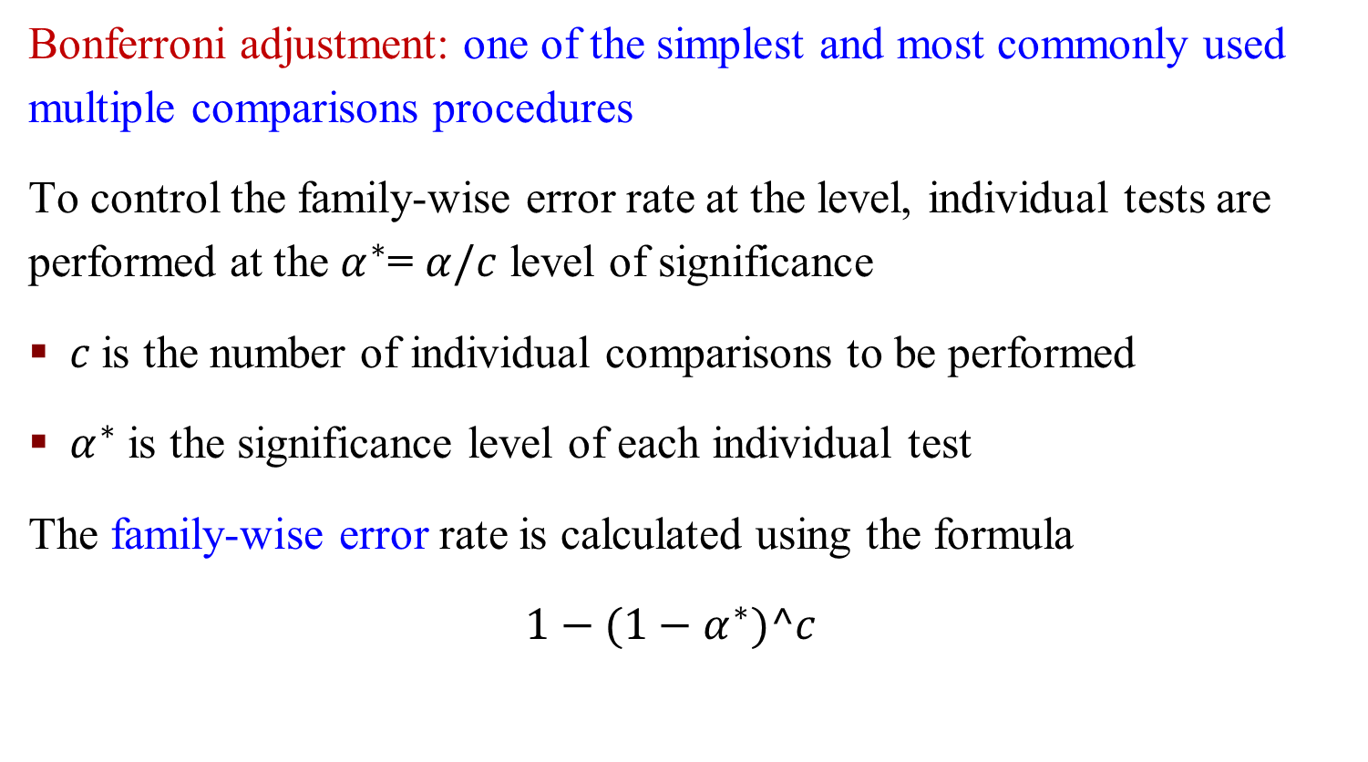
Issues with Multiple Comparisons – Bonferroni Adjustment
Bonferroni adjustment: one of the simplest and most commonly used multiple comparisons procedures
To control the family-wise error rate at the level, individual tests are performed at the $α^{∗}$= $α/c$ level of significance
$c$is the number of individual comparisons to be performed
$α^{∗}$ is the significance level of each individual test
The family-wise error rate is calculated using the formula
$$1−(1−α^{∗})^c$$

Slide 39
Tukey Procedure
The Studentized Range test or Tukey’s Test of Honest Significance Test is another common multiple comparisons procedure commonly used to control the family-wise type I error rate for pairwise comparisons.
It tends to have more statistical power (is less conservative) than the Bonferroni method, especially when there are a large number of pairwise comparisons
The procedure is generally implemented using statistical software like R

Slide 40
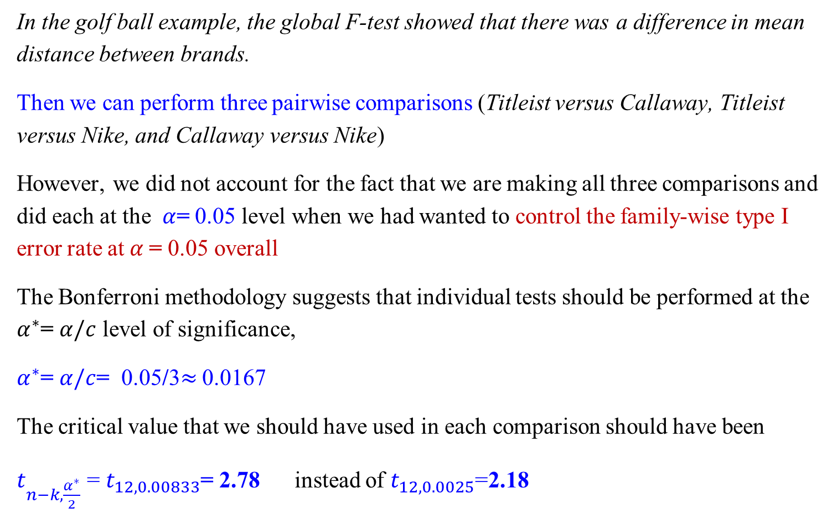
Issues with Multiple Comparisons – Golf Example
In the golf ball example, the global F-test showed that there was a difference in mean distance between brands.
Then we can perform three pairwise comparisons (Titleist versus Callaway, Titleist versus Nike, and Callaway versus Nike)
However, we did not account for the fact that we are making all three comparisons and did each at the $α$= 0.05 level when we had wanted to control the family-wise type I error rate at $α$= 0.05 overall
The Bonferroni methodology suggests that individual tests should be performed at the $α^{∗}$= $α/c$ level of significance,
$α^{∗}$= $α/c$= 0.05/3$≈$ 0.0167
The critical value that we should have used in each comparison should have been
$t_{n−k,\frac{α^{∗}}{2}}$ = $t_{12,0.00833}$= 2.78 instead of $t_{12,0.0025}$=2.18

Slide 41
The Golf Example R Command
Pairwise comparisons using t-tests
P value adjustment method: Bonferroni

Slide 42

The Golf Example R Command
Create Anova model and getting summary results

Slide 43
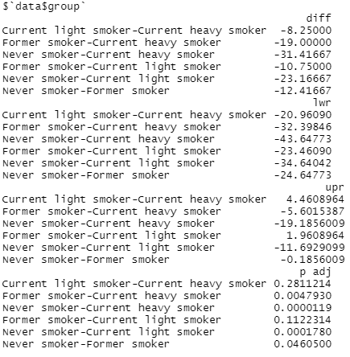
Example SBP by Smoking Status

